Slide 1

How to move investors to YES?!!
<name>
<title>
<contact info

Slide 2
Master your startup fundraising
The Basics
How to Prepare
The Pitch
After The Pitch
If we will have time
Funding Vehicles
MICROSOFT CONFIDENTIAL. FOR INTERNAL DISCUSSIONS ONLY
Notes:
Each investor views the world differently so this guide is far from definitive.
I couldn’t include every accelerator, angel or VC.
I’m not a lawyer so consult with one before you raise.
The focus is seed but many lessons apply for Series A.

Slide 3

The Basics

Slide 4
It’s All About One Thing….
Show me the money!

Slide 5
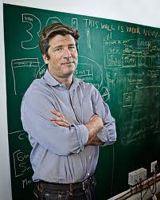
It’s all starts with an Idea…but:
A team, with different capabilities that are passionate about the venture. Single founder? Start dating!
Willing to work with no salary for 1-1.5 years
“Remember that funding is a means to an end, not an end in of itself. The end is building a product, building a community and building a business. Raising money can be a challenge – just remember it’s not the end. It’s the beginning, it’s the starting point. Now you have to build.”
John Borthwick, Betaworks
MICROSOFT CONFIDENTIAL. FOR INTERNAL DISCUSSIONS ONLY

Slide 6

Things to Remember…
Notes:
“Remember that funding is a means to an end, not an end in of itself. The end is building a product, building a community and building a business. Raising money can be a challenge – just remember it’s not the end. It’s the beginning, it’s the starting point. Now you have to build.”

Slide 7
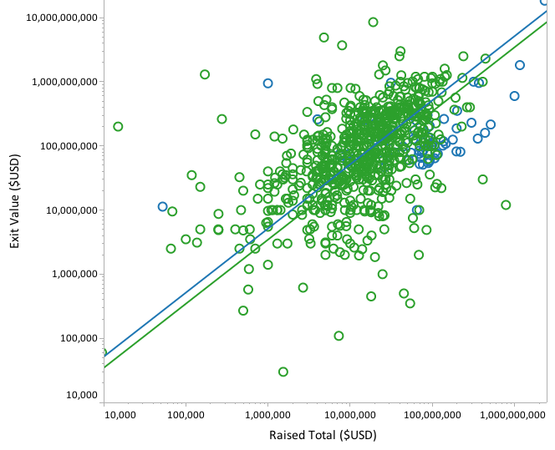
The flow of ideas, money, and equity
The flow of ideas, money, and equity
Huge exits are rare….
The average successful US startup has raised $41M and exited at $242M
The average successfully acquired US startup has raised $29.4M and sold for $155.5M
The average IPO-bound startup raised $162M before going public
And those are just the successful ones….
Source: http://info.crunchbase.com/2013/12/16

Slide 8
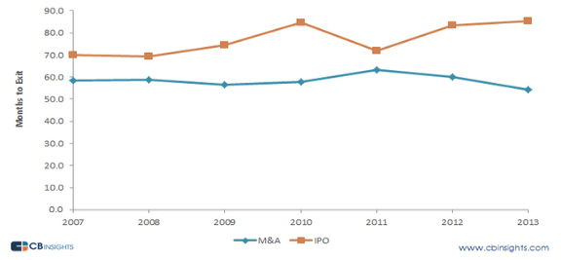
The flow of ideas, money, and equity
The flow of ideas, money, and equity
It takes more the 6 years to Exit\IPO
Source: http://www.cbinsights.com/blog/trends/venture-capital-exit-timeframe-tech
Notes:
Entrepreneurs typically receive funding from venture capital firms or angel investors (sometimes funding comes from corporations or the government)
Venture capital investors provide financial capital to early-stage, high-potential, growth startup companies. Venture capital funds typically earn money by owning equity in the companies they invest in.
Venture Capital investments are considered very high risk but with above-average return prospects
Investors typically expect a smaller percentage of their portfolio companies to experience exponential growth but expect to profit greatly from such events
Venture Capital investors are not in it for the long-term. They are looking to invest in “a company’s balance sheet and infrastructure until it reaches a sufficient size and credibility so that it can be sold to a corporation or so that the institutional public-equity markets can step in and provide liquidity”
Source: Wikipedia http://en.wikipedia.org/wiki/Venture_capital

Slide 9

The flow of ideas, money, and equity
The flow of ideas, money, and equity
Your life in that 6 years…..
Notes:
Great big wins, hard hart breaking struggles

Slide 10
Does every startup have to raise??
NO!!!- not raising is a viable option, but….

Slide 11

The flow of ideas, money, and equity
The flow of ideas, money, and equity
Bootstrap!!
Pull yourself up by your bootstrap
Lots of advantages:
keep 100% of your equity
report to no one but yourself
Building for profitability- no cash=no company
Once bootstrapped doesn’t mean forever bootstrap
Success stories: Pyramid analytics, GitHub etc..
But…..
Notes:
If external $$ won’t make you grow faster or you don’t want to grow fast . Don’t raise money.

Slide 12
So, why the $%^$^ would I raise?

Slide 13
The flow of ideas, money, and equity
The flow of ideas, money, and equity
Why to raise outside funding?
Ambition
Reach Global domination is easier with capital and global support
Growth, Timing
Faster growth enables you to conquer your market ahead of your competition
Expand Network
Building a business can be very lonely- investors can act as mentors, sparring partners and helpers. Also can open doors and have network and experience…
Success stories: Google, Waze, Facebook, Skype etc…
Notes:
Entrepreneurs typically receive funding from venture capital firms or angel investors (sometimes funding comes from corporations or the government)
Venture capital investors provide financial capital to early-stage, high-potential, growth startup companies. Venture capital funds typically earn money by owning equity in the companies they invest in.
Venture Capital investments are considered very high risk but with above-average return prospects
Investors typically expect a smaller percentage of their portfolio companies to experience exponential growth but expect to profit greatly from such events
Venture Capital investors are not in it for the long-term. They are looking to invest in “a company’s balance sheet and infrastructure until it reaches a sufficient size and credibility so that it can be sold to a corporation or so that the institutional public-equity markets can step in and provide liquidity”
Source: Wikipedia http://en.wikipedia.org/wiki/Venture_capital
“The other time not to raise money is when you won’t be able to. If you try to raise money before you can convince investors, you’ll not only waste your time, but also burn your reputation with those investors.” Paul Grahm YC

Slide 14
The flow of ideas, money, and equity
The flow of ideas, money, and equity
Sources Of Capital
Friends and Family
Crowdfunding
Grants
Seed Funds
Bank Loans
Venture Capital (VC)
Angels
Strategic (CVC)
Accelerators
Private Equity (PE)
Only relevant for advanced stages
Incubators
Public Market
Notes:
Angels- high net worth individuals, ex entrepreneurs, corp executives, go for ones with great value (expertise, network, know how),
Crowd funding- equity or pre sale-
Accelerators- A three to six month “startup boot camp” that provides mentoring, office space and access to capital in exchange for 3-6% of common stock.
Incubators- in some contires there are government plans with the OCS\government\municipality to get funding and space with detailed terms
Seed funds tend to invest $50K - $750K in an institutional seed round which is usually up to $1.5M. These funds invest together as a syndicate.
VC-VCs typically lead $3M-$10M+ Series A rounds but some invest $50K - $1M in seeds to back great founders and / or learn about emerging tech.
When to go to each type of investor

Slide 15
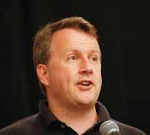

When to raise? Stages of Investment
Pre-Seed
Expansion- C,D,E, IPO
Exit of VC
Seed
Series A
Series B
Idea\ Prototype
Product Market fit
Go To Market- early sales and\or production
Accelerate\
Growth- most of the time not yet profitable
Rollout- for a profitable company to expand
Bridge Financing for taking a company public
“The other time not to raise money is when you won’t be able to. If you try to raise money before you can convince investors, you’ll not only waste your time, but also burn your reputation with those investors”. Paul Graham
Notes:
Seed funding: Low level financing needed to prove a new idea, often provided by angel investors. Crowd funding is also emerging as an option for seed funding.
Start-up: Early stage firms that need funding for expenses associated with marketing and product development
Growth (Series A round): Early sales and production funds
Second-Round: Working capital for early stage companies that are selling product, but not yet turning a profit
Expansion: Also called Mezzanine financing, this is expansion money for a newly profitable company
Exit of venture capitalist: Also called bridge financing, 4th round is intended to finance the "going public" process
Decision makers vs. gate keepers
Too many meetings indication

Slide 16

What does it mean for You??!!

Slide 17
Terminology
Term Sheet: Document detailing the terms of the investment
No Shop: exclusivity term in which the company can’t solicit other investors\buyers
Due Diligence: Reviewing and analyzing all aspects of the business and the deal
Pre\Post Money Valuation: the value of the company stocks prior to investment or financing
Burn Rate: How quickly a startup uses its funding before generating revenue
Capital Commitment: When an investor commits to investing a given amount in a venture capital fund
Preferred shares: A class of ownership that has a higher claim on the assets and earnings than common shares
Right of first refusal (ROFR)- initial right (not obligation) to enter a transaction (mainly for sale of shares\ M&A)
IPO (Initial Public Offering): The official term for when a company is taken public
No Sale: limitation to sale shares (mainly founders)
Convertible Securities\debt\loan: a loan that converts (automatically or not) into equity upon the closing of a round of financing (with interest or without)
Pro Rata\Dilution: proportionate allocation. A method of assigning an amount to a fraction, according to its share of the whole. No pro rata= dilution in shares
IRR: Internal rate of return
MICROSOFT CONFIDENTIAL. FOR INTERNAL DISCUSSIONS ONLY
Notes:
Burn Rate: the rate at which a start-up uses its venture capital funding before it begins earning any revenue.
Capital Commitment: Every investor in a venture capital fund commits to investing a specified sum of money in the fund partnership over a specified period of time. The fund records this as the limited partnership’s capital commitment. The sum of capital commitments is equal to the size of the fund. Limited partners and the general partner must make a capital commitment to participate in the fund.
Deal Flow: The number of potential investments that a fund reviews in any given period. Venture capital firms receive hundreds of business plans each month. From among these, a VC firm typically will fund only a small percentage of them, usually less than 0.5%. An organization's deal flow is considered good if it results in enough revenue or equity generating opportunities to keep the organization running.
Due Diligence: Investing successfully in private equity at a fund or company level, involves thorough investigation. As a long-term investment, it is essential to review and analyse all aspects of the deal before signing. Capabilities of the management team, performance record, deal flow, investment strategy and legals, are examples of areas that are fully examined during the due diligence process.
IPO: An IPO is the official term for ‘going public’. It occurs when a privately held company – owned, for example, by its founders plus perhaps its private equity investors – lists a proportion of its shares on a stock exchange. IPOs are an exit route for private equity firms. Companies that do an IPO are often relatively small and new and are seeking equity capital to expand their businesses.
IRR: This is the most appropriate performance benchmark for private equity investments. In simple terms, it is a time-weighted return expressed as a percentage. IRR uses the present sum of cash drawdowns (money invested), the present value of distributions (money returned from investments) and the current value of unrealised investments and applies a discount.
Ratchets: Clauses protecting against equity dilution if subsequent rounds of financing at lower values take place
Strategic Investment: An investment that a corporation makes in a young company that can bring something of value to the corporation itself. The aim may be to gain access to a particular product or technology that the start-up company is developing, or to support young companies that could become customers for the corporation’s products. In venture capital rounds, strategic investors are sometimes distinguished from venture capitalists and others who invest primarily with the aim of generating a large return on their investment. Corporate venturing is an example of strategic investing.
Term Sheet: A summary sheet detailing the terms and conditions of an investment opportunity.
https://www.altassets.net/private-equity-and-venture-capital-glossary-of-terms
https://vcexperts.com/encyclopedia/glossary/deal-flow

Slide 18
The flow of ideas, money, and equity
The flow of ideas, money, and equity
Valuation in a Nutshell
Enable Value creation
Note: Investors (specially VCs) come with high expectations for return, board seats and reporting

Slide 19

Its all about one thing- Show Me The Money

Slide 20
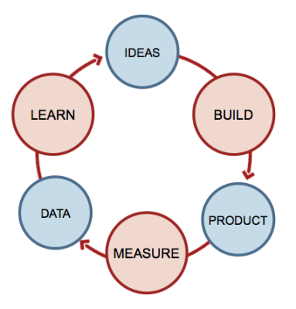

The flow of ideas, money, and equity
The flow of ideas, money, and equity
Not So Fast You Need To Prepare
If technically feasible you should launch a minimum viable product (MVP) before raising capital.
Benefits of launching:
Validate early hypotheses
Social proof / traction
Feedback from real customers
Evidence team can ship
Develop “bootstrapper” mentality
Easier to raise capital
“If you weren’t embarrassed by the first version you launched too late.”
-Reid Hoffman (LinkedIn, Greylock Partners)
Notes:
When you prepare

Slide 21
The flow of ideas, money, and equity
The flow of ideas, money, and equity
Be Structured and Planned
Find a good Lawyer- Once you determine the right funding option for your company make sure you partner with an experienced law firm
Advisors\Mentors- Before you kick off the fundraising process, build an experienced advisory board that can help with strategy, introductions and general advice.
Structure a process- Create a spreadsheet or use a CRM like Streak.com for targeting and tracking your investors conversations
Set round size- Estimating the amount of capital you’ll need requires more art than science. Here are some tips to keep in mind during your quest.
Runway: Raise enough capital to give yourself 18 months. Keep in mind it will likely take 3-6 months to raise a Series A.
Dilution: Every time you raise a round, try to sell no more than 10-25% of the company.
Target $: Set a modest raise amount. It’s always better to nail your target, say you’re “oversubscribed” and then increase the size of round depending on investor interest and terms / dilution.
Notes:
Facebook eduardo saverin- dilution and lawyer

Slide 22
The flow of ideas, money, and equity
The flow of ideas, money, and equity
Choose the right investor
Selecting your investors is like selecting a partner - there are a variety of factors that should go into the decision making process beyond the financial terms
Investment Strategy and Stage – typical ticket size, stage, type of companies
Expertise and focus- areas, sectors, verticals, connections
Partner- who is he, do you want him on your board, what does he brings to the table, reputation
Brand
Support & relationships- what doors can the investor open, what kind of support you can receive
Location- does this investor can help in your target market, does it’s location add value

Slide 23

What's the story?
Notes:
The “story” behind your company and product is often one of the most important things an investor will want to know. Don’t underestimate it.
A good story have, charisma, and strong link to the founder all packed in one short concise story line
Have a story not a presentation that is packed with charts, numbers and architecture (you will have time for that, but not in the first date)
Your goal throughout the process should be to create excitement, demand and scarcity for your round. Investors often move in packs.
Large market up for disruption, passion, and why is this team going to do it

Slide 24
Don’t confuse the pitches
Elevator Pitch
Explain your business/opportunity in one sentence
Best for networking events and email intros
In-Person Presentation
Explain your business/opportunity in 10-15 slides
Best for 30 minute meetings
Detailed Business Plan
Explain your business/opportunity in 25-50 pages
Best for deeper dives during diligence—not upfront

Slide 25
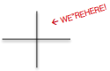
The flow of ideas, money, and equity
The flow of ideas, money, and equity
Pitch Structure
Title+ contact + 1 liner
Get them interested
Problem
Vision, Mission, Product, show them what you done, should get them excited
Solution
Market
Top Down\Bottom up- try to be relevant
Competition
GTM- Distribution\CAC
How are you going to reach the audience\ customers
Business model
Who is paying\ unit cost\packages etc.

Slide 26
The flow of ideas, money, and equity
The flow of ideas, money, and equity
Pitch Structure
Roadmap\Timeline
What, where, when, how
Traction\Milestones
Projections\Metrics
AKA- what are you going to achieve with the $$
Team\Advisors
Can come before if it’s key part of the story
Funding
Clear statement of how much you want and what are you going to achieve
If they are still with you→ good chances you will have a 2nd date

Slide 27
What to avoid…
https://www.youtube.com/watch?v=J-GVd_HLlps

Slide 28

Move to a Yes!!!

Slide 29
The flow of ideas, money, and equity
The flow of ideas, money, and equity
It’s a process….
Understand the forces- on you and on investors
Fundraise or don’t
Get intros- now one invest on a cold mail in his LinkedIn and\or email
It’s all no until it’s a yes- remember they want to wait. If they can’t commit treat that as a no
Parallel rather than serially- higher prospect\value=higher priority and attention
Know your status- know the next steps, what is their process and how are your progressing. if they are interested they will love to answer
First commitment
Close committed $$- it ain’t over till the $$ are in the bank
Notes:
Investors are pinched between two kinds of fear: fear of investing in startups that fizzle, and fear of missing out on startups that take off. To reduce the risk they would love to just wait. So Create atmosphere of the next big thing, know that rapid growth and work in parrlel are keys to success. Go by the rules- don’t deviate as you can lose the way.
Fundraise or don’t- don’t waste your time in a ever ending process. Be focused, get it done quickly and do that. You can take money when you are not fundraising, but don’t waste time on convincing or negotiating in the process. Don’t waste time on non decision makers in cold emails. Meet only when you need it and with decision makers.
It’s all no until it’s a yes- yes is only an offer with no contingents, all the rest treat as no. remember they want to wait. They will stall, take more meeting, and maybe never say no. if they are committed- ask for their confirmation, if you don’t get it they are not committed. If they can
Parallel rather than serially- Expected value = how likely an investor is to say yes, multiplied by how good it would be if they did. Reduce the time wasters, the never no. signs: not responding, too many meetings without progress,
Close committed $$- know what is the timeline to get the $$ in your account. They can always discover new stuff after saying yes and before the $$ are yours

Slide 30
The flow of ideas, money, and equity
The flow of ideas, money, and equity
It’s a process….
Avoid “no leaders”- at least try to. Since most seed are no leads, that just means he is looking for confirmation that you are as hot as he assumes
Underestimate what you need to get oversubscription
Be profitable if you can or at least grow like crazy
Don’t optimize valuation
Yes before valuation- for first investor
One man handles fund raising
Stop fundraising when it stop working
Be the good guy- don’t burn bridges, be a pro, avoid arrogance. When you reject and when you are being rejected
Notes:
No leaders- if they are a big investors they would love to lead. Remember first yes will bring the others. Good to have the yes from a leader. Nowdays
Be profitable if you can- if you are not desperate for money the deal is better. It’s easier to rasie when you don’t need it
Don’t optimize your valuation- it’s more important to have revenue not valuation. Try to get a convertible note to avoid the mess

Slide 31


Slide 32
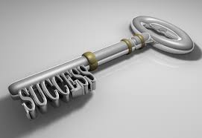
The flow of ideas, money, and equity
The flow of ideas, money, and equity
The Keys
Get a warm intro
Know who you are pitching to
First impression
Problem first
Know your field
Know your weaknesses- be honest about them
Show what you have done
Show that you can scale
Have a plan
Notes:
Get a warm intro- referrals with recommendation can bring the meeting faster
First impression- =Most VCs usually form an opinion of the founder and opportunity within first 10 minutes of a pitch- Early stage investors generally look for: traction, you+team, proof, product
Know your filed- know the market the competition the challenges and the business environment- it’s your area of operation your investors want to back expert
Know your weaknesses- Investors would rather back an entrepreneur who is honest, who knows her flaws, and who has a reasonable hypotheses about how she might overcome these challenges with more resources and time.
Show what you have done- product demos, metrics (KPIS, engagement),
Have a plan- what is the next few milestones look like, how much money do you need for how long and for what milestone, how are you going to address the weaknesses
Show that you can scale- positive unit economics, how you will get users\customers\ scale!!
All you do should be data driven, great design that reflect your deep knowledge of the problem and your vision to the solution

Slide 33

The flow of ideas, money, and equity
The flow of ideas, money, and equity
Things to Avoid
Product demos that don’t work
Derivative product and positioning
Long answers filled w/ buzzwords
Trying to have all the answers
Long pitch decks
Don’t have clear raise amount
Asking for investor intros after one passes
Overemphasizing PR and press
No product team in place
Pitching different partners in firm after a pass
Bringing non-founders to 1st meeting
Too many emails / follow ups
Notes:
Every investor acts differently- but in 90% of the cases this will stick

Slide 34

The flow of ideas, money, and equity
The flow of ideas, money, and equity
Things You Can Ask
What are the next steps in the process?
What concerns do you have?
How much time do you typically spend with your companies?
Can you walk me through your decision making process?
How do you think you can help our company?
Do you lead and / or follow?
What’s your typical check size?
How does your firm think about follow on investments?
Is there any additional information you’d like to see?
Which investors do you enjoy working with?
Notes:
During the process make sure you carve out enough time to learn about the firm, its process and how they think about your opportunity.
Always: Immediately following each pitch session there are some best practices you can implement which should help you throughout the process.
Debrief w/ Team
Send VC Requests (action items)
Review your notes
Note: questions issues raised
Edit pitch deck and story
Update the investors pipeline

Slide 35
The flow of ideas, money, and equity
The flow of ideas, money, and equity
Things You Can Ask
What are the next steps in the process?
What concerns do you have?
How much time do you typically spend with your companies?
Can you walk me through your decision making process?
How do you think you can help our company?
Do you lead and / or follow?
What’s your typical check size?
How does your firm think about follow on investments?
Is there any additional information you’d like to see?
Which investors do you enjoy working with?
Notes:
During the process make sure you carve out enough time to learn about the firm, its process and how they think about your opportunity.
Always: Immediately following each pitch session there are some best practices you can implement which should help you throughout the process.
Debrief w/ Team
Send VC Requests (action items)
Review your notes
Note: questions issues raised
Edit pitch deck and story
Update the investors pipeline

Slide 36
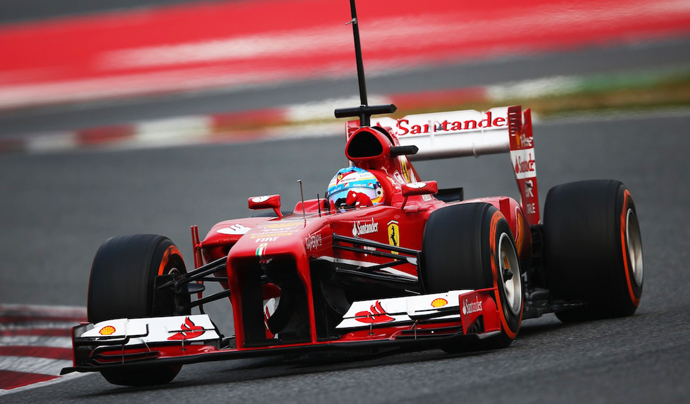
Seed Funding Vehicles
.
Notes:
Benefits include
Free office space and $60k Microsoft Azure Cloud credit
Full curriculum of business and technical training
Mentorship, high-profile exposure, and global access to customers and investors

Slide 37
The flow of ideas, money, and equity
The flow of ideas, money, and equity
Convertible Debt
Convertible debt (A.K.A Convertible Note, A.K.A. Convertible Loan) is when a company borrows money from an investor or a group of investors and the intention of both sides is to convert that debt to equity at some later date
Key Terms/Elements
Why Convertible Debt?
Discount- The % reduction in price the debt holders will get when they convert into equity in the future
Valuation Cap- A valuation ceiling on the conversion price of the debt (common for seed deals)
Conversion- Point in time when holders of the debt will convert their investment into equity (typically occurs in the first equity funding round following the convertible debt issuance)
Speed- Simpler terms and less paperwork so can close within weeks
Cost-Cheaper than equity from a legal perspective
Control-Founder retains majority of voting stock
Valuation- Delays valuation discussion unless note is capped

Slide 38
The flow of ideas, money, and equity
The flow of ideas, money, and equity
Seed Preferred
Seed Preferred is a type of equity seed funding instrument that provides certain rights, privileges and preferences to investors
Key Terms/Elements
Why Seed Preferred?
Price / Valuation-Pre-money valuation / price-per-share
Liquidation Preference- Amount VCs receive in sale before proceeds are shared with founders based on ownership
Founder Vesting-Determines timing of when founders and employees earn their equity (e.g. 4 years)
Pro-Rata Right- Right for VCs to invest in future rounds
Board Seats- Lead investors usually require board seat privileges to vote in strategic decisions
Alignment of Interests- Both the founder and investor have unlimited upside
Valuation- Sets baseline valuation right on closing date
Tax Implications-Capital gains clock begins to tick
Industry Standard-Many seed deals are currently being funded with seed preferred

Slide 39
The flow of ideas, money, and equity
The flow of ideas, money, and equity
Safe
SAFE – Simple Agreement for Future Equity (AKA convertible security) – is a newly-formed funding instrument meant to replace convertible notes; essentially, SAFE has the benefits of convertible debt without the debt portion (maturity date and accrued interest).
Key Terms/Elements
Why Safe?
Equity Financing Event-SAFE investors will be issued a form of preferred stock, and the SAFE instrument will expire
Liquidity Event-SAFE investors will be have the option to receive cash payment or common stock, and the SAFE instrument will expire
Dissolution Event-SAFE investors would have preference over capital stock owners in the distribution of assets
No Maturity Date-Less pressure on startup to raise further capital in tight timeframe
No Accrued Interest -SAFE is not a loan – founders will not owe accrued interest
Speed-Very simple terms and quick funding timeline
Cost- Limited transaction costs due to standardized forms

Slide 40
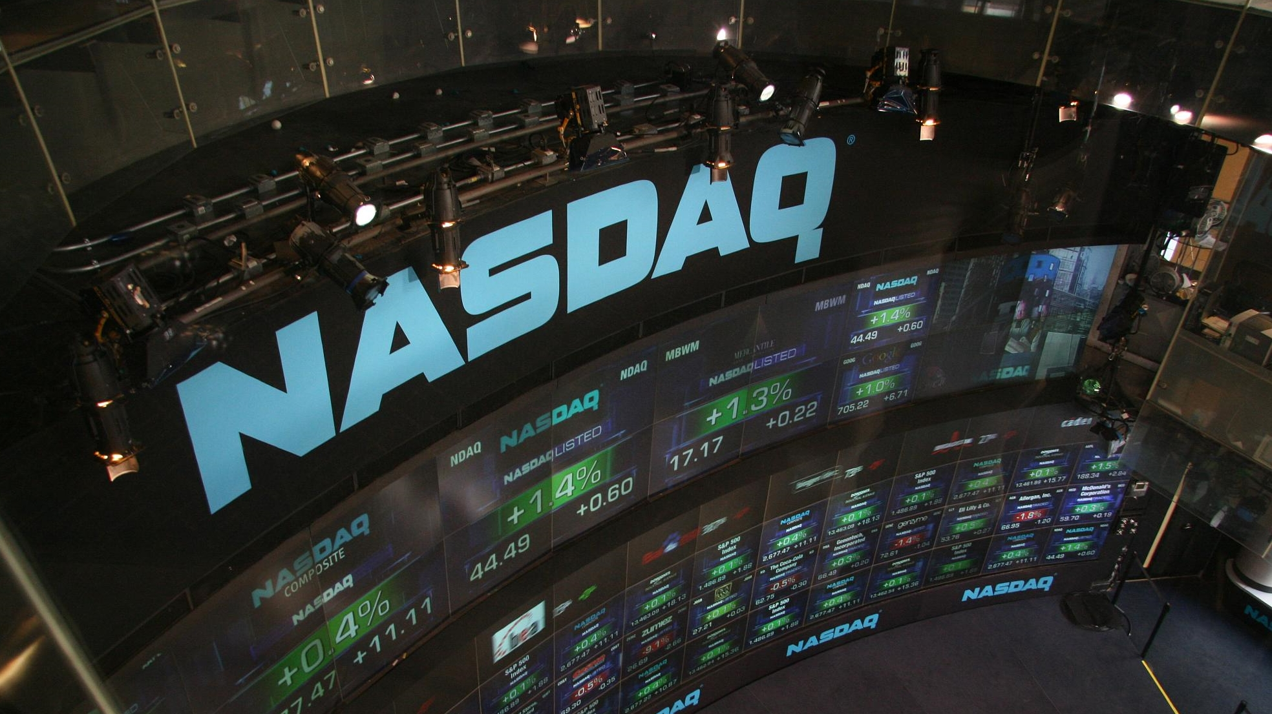
Post investment

Slide 41




The flow of ideas, money, and equity
The flow of ideas, money, and equity
So you got the $$, now what?
Intros to customers\helpers
Meet w\other portfolio founders
Update\Communicate
Hiring
Strategy Sessions
Crises management
Notes:
Let the VC really be a partner and put them to work. Many of them have supporting orgs for hiring and mentoring

Slide 42
The flow of ideas, money, and equity
The flow of ideas, money, and equity
One last thought….
Remember the funding is only the mean to an end
The real work is to build a product and measured by creating revenue
Oh, and try to have fun….

Slide 43

Questions??

